Slide 1
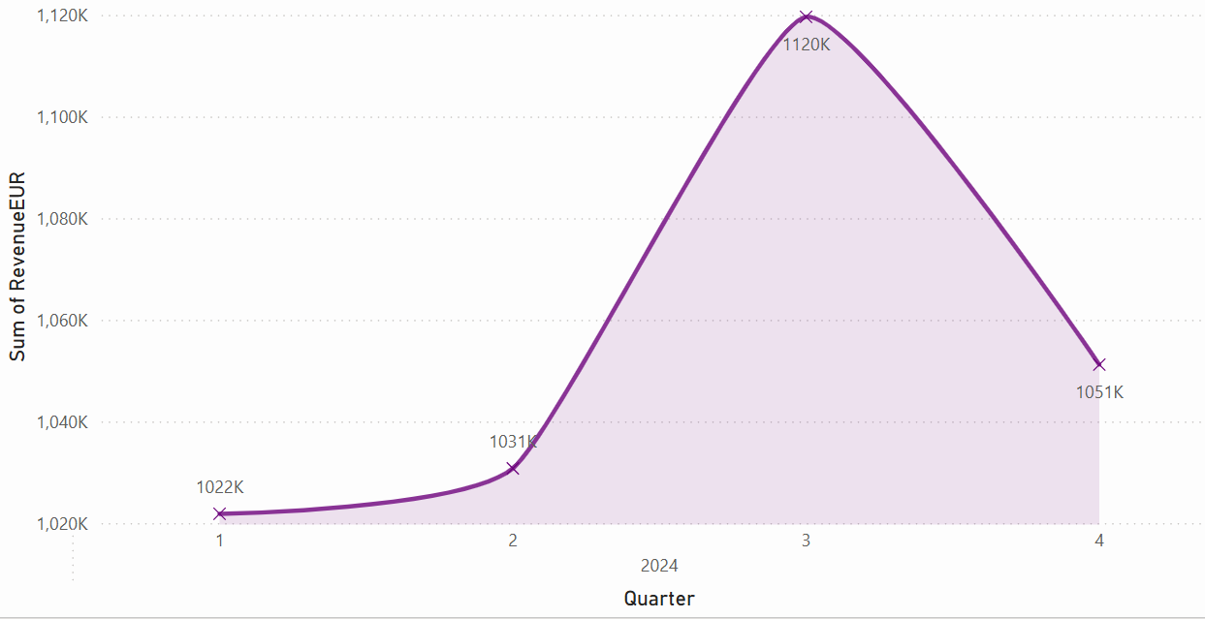
Sum of sales by year and quarter
Highest:2024 3
Lowest:2024 1

Slide 2
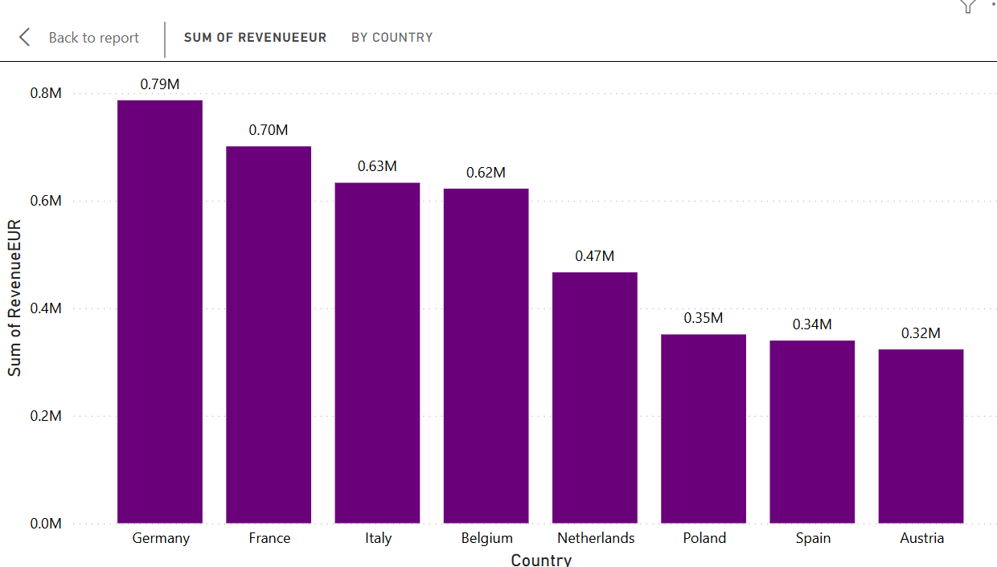
Sum of sales by year
Highest: Germany
Lowest: austria

Slide 3
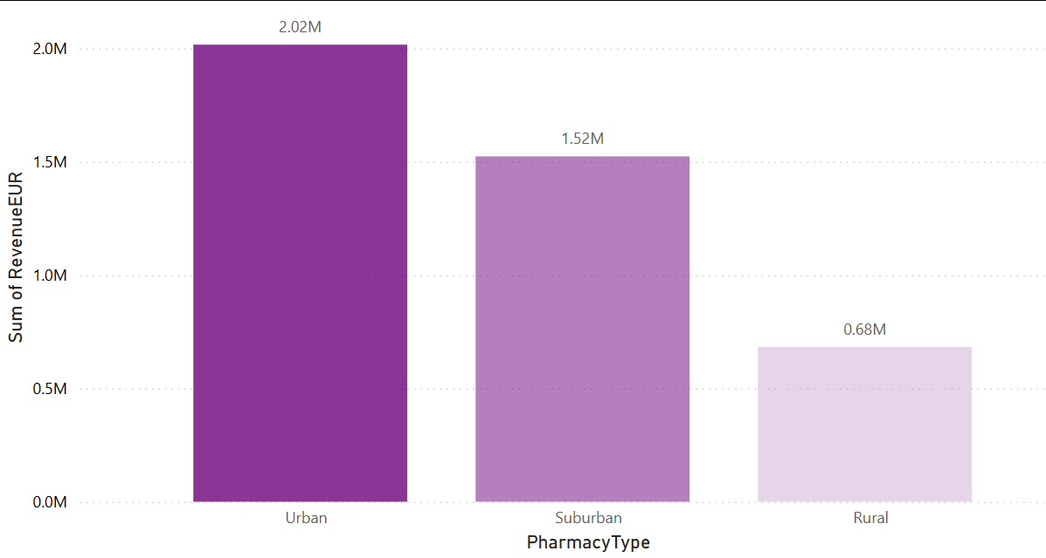
Sum of sales by pharmacy type
Highest:urban
Lowest:rural

Slide 4
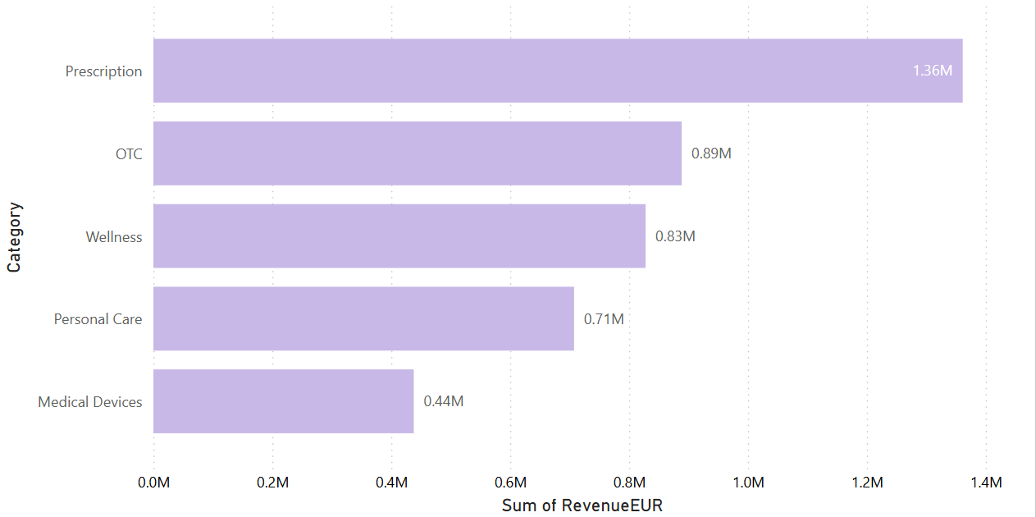
Sum of sales by category
Highest:prescription
Lowest: medical devices

Slide 5
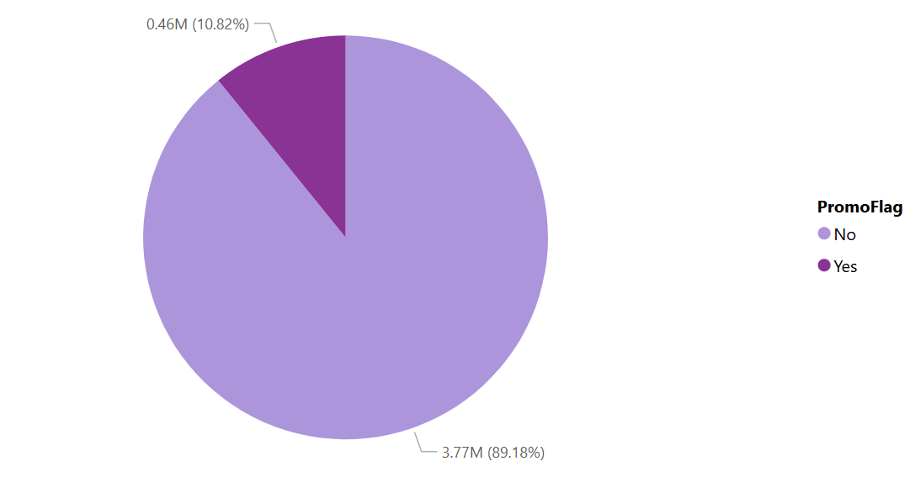
Sum of sales by promo flag
Highest:No
Lowest:yes

Slide 6
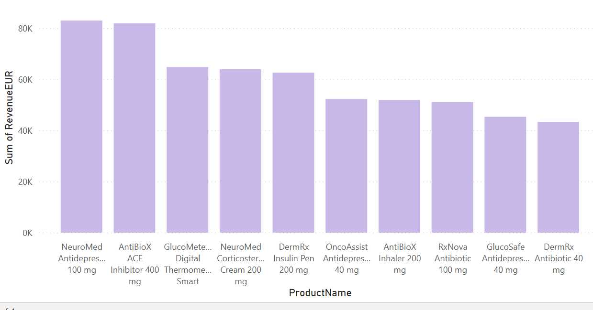
Sum of sales by product name
Highest: Neuro Medanti deprresnt
Lowest: DermiRx Antibiotic

Slide 7
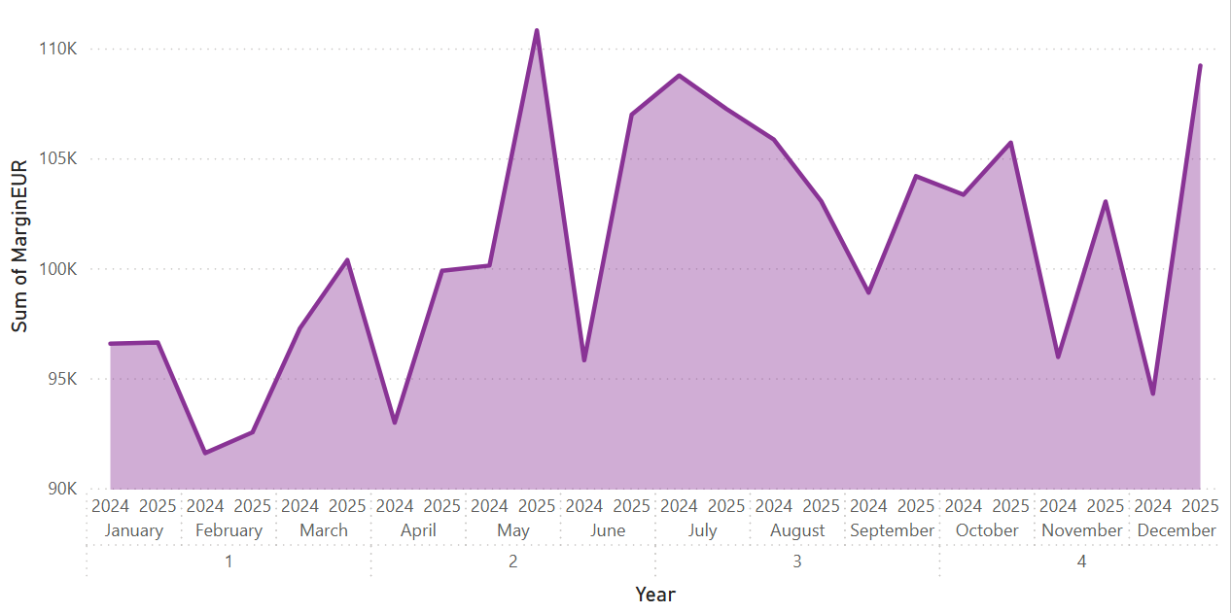
Sum of profit by year
Highest:2 2025 may
Lowest:1 feb 2024

Slide 8
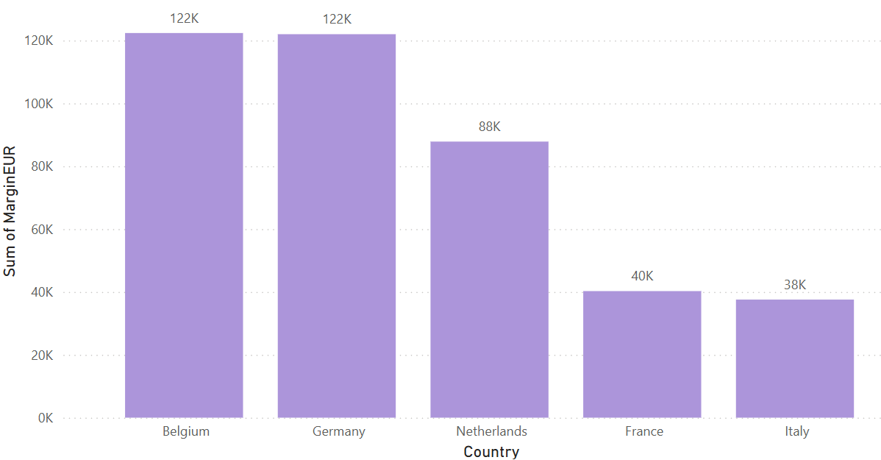
Sum of profit by country
Highest:Belgium,germany
Lowest:italy

Slide 9
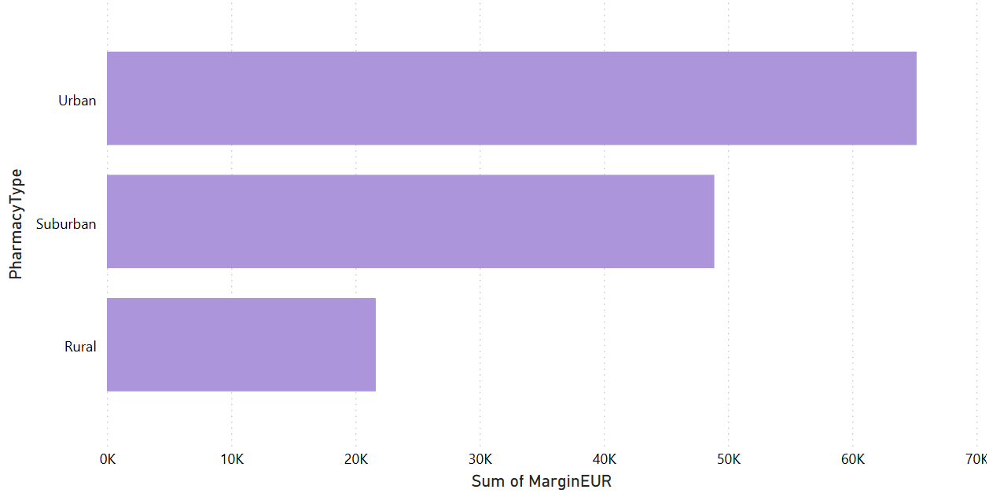
Sum of profit by pharmacy type
Highest: Urban
Lowest: Rural

Slide 10
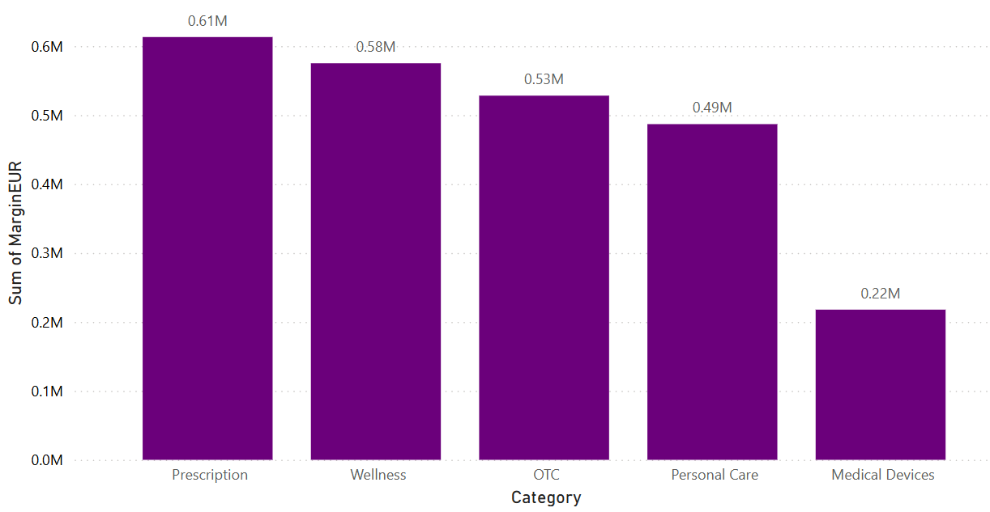
Sum of profit by category
Highest: Prescription
Lowest: Medical devices

Slide 11
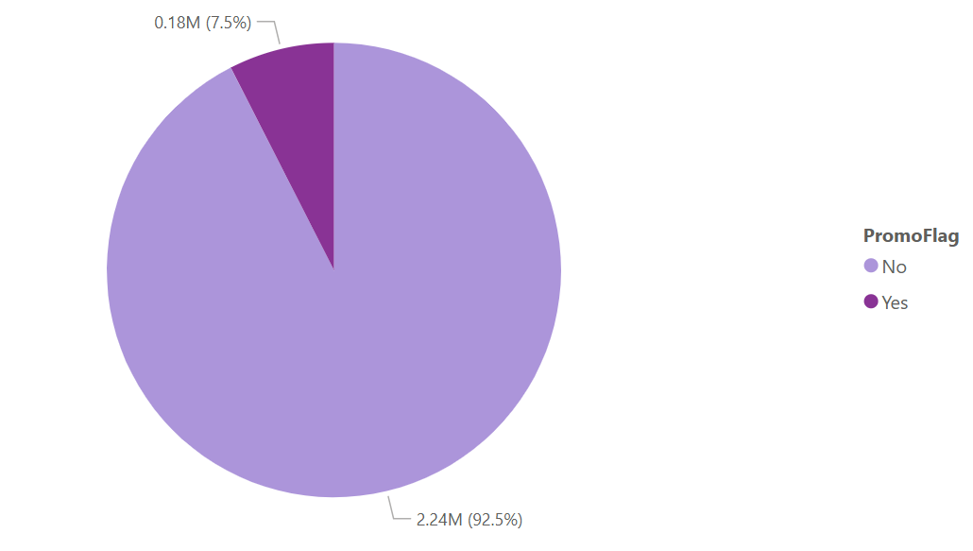
Sum of profit by promoflag
Highest: No
Lowest: Yes

Slide 12
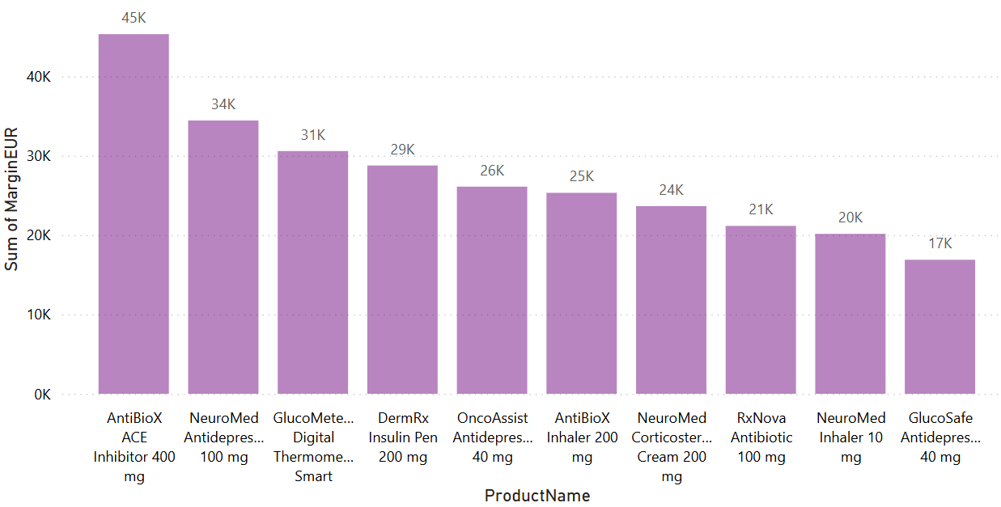
Sum of profit by product name
Highest: AntiBioX ACE inhibiter
Lowest: Gluco Anti depressnt

